Slide 1
Weekly meeting
5 2 2024
Ty Bottorff

Slide 2
Outline
P576-1 PCAs, VPs, comparing to P452

Slide 3
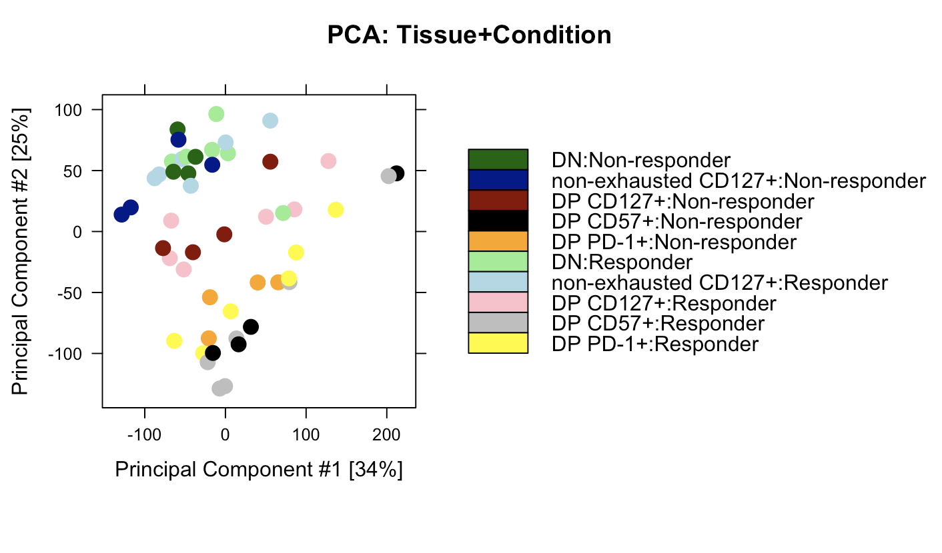
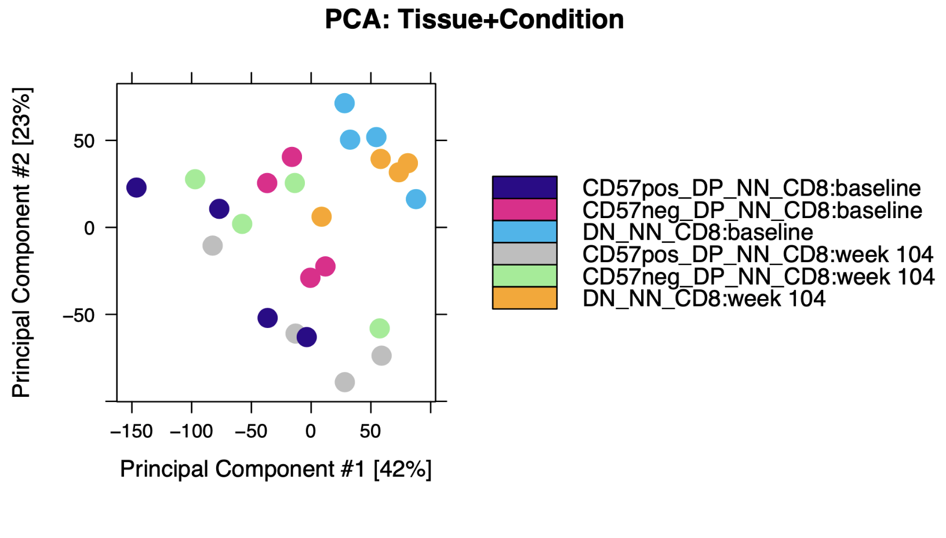
Variability among replicates not very different from P452
P576
P452 (Erin’s)

Slide 4
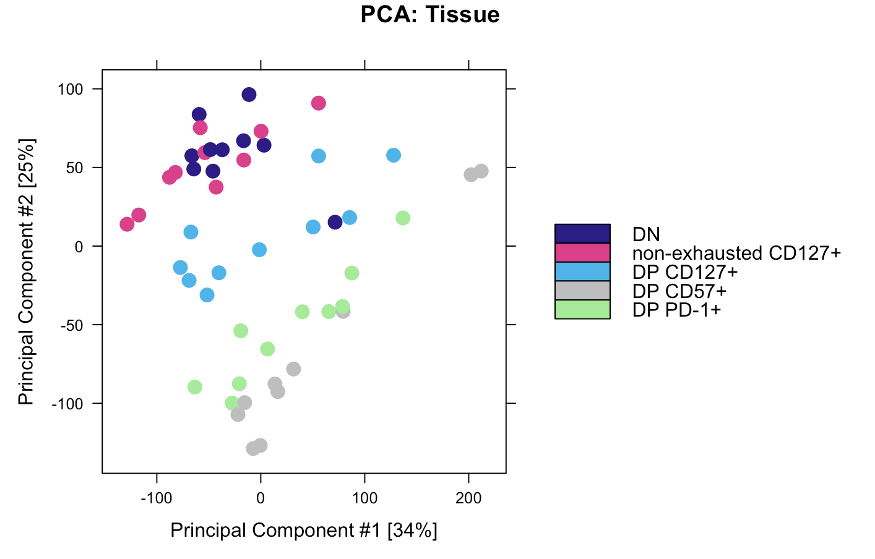
DP CD127⁺ appears to be distinct, non-intermediate cell state from DP PD-1⁺ and DP CD57⁺

Slide 5
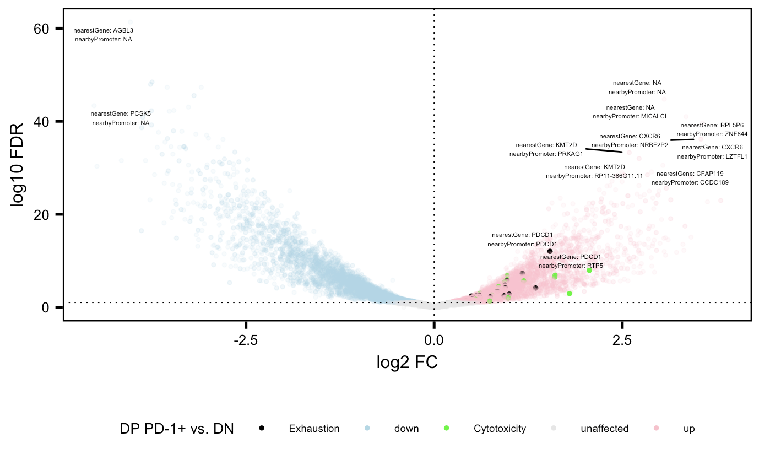
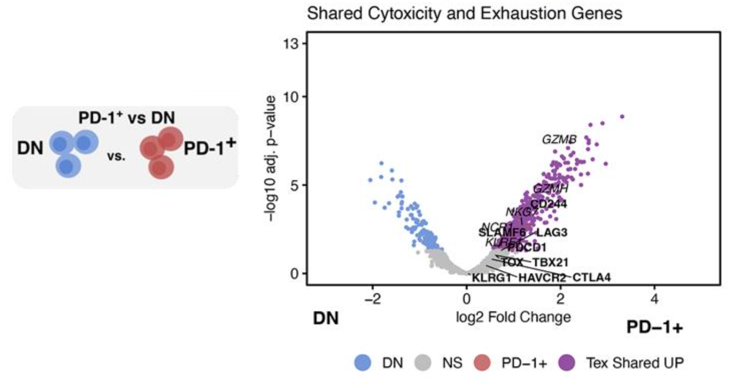
Cytotoxicity and exhaustion genes more accessible in DP PD-1⁺ relative to DN in both projects
P576
P452 (Erin’s)

Slide 6
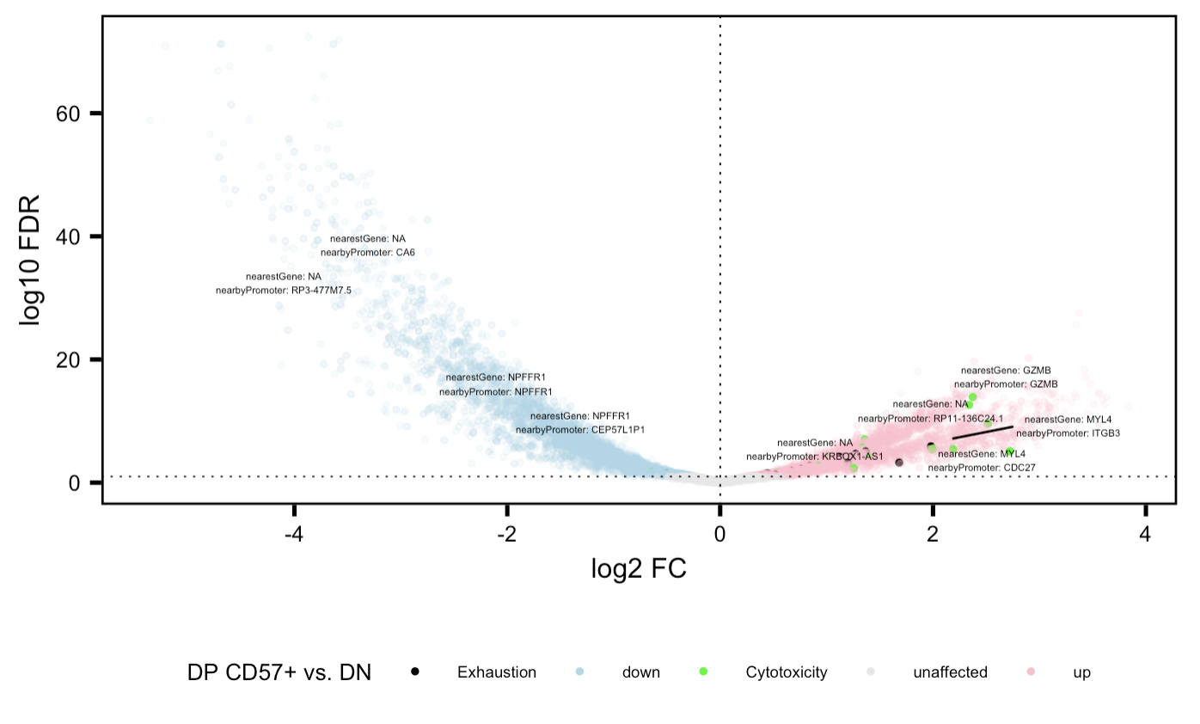
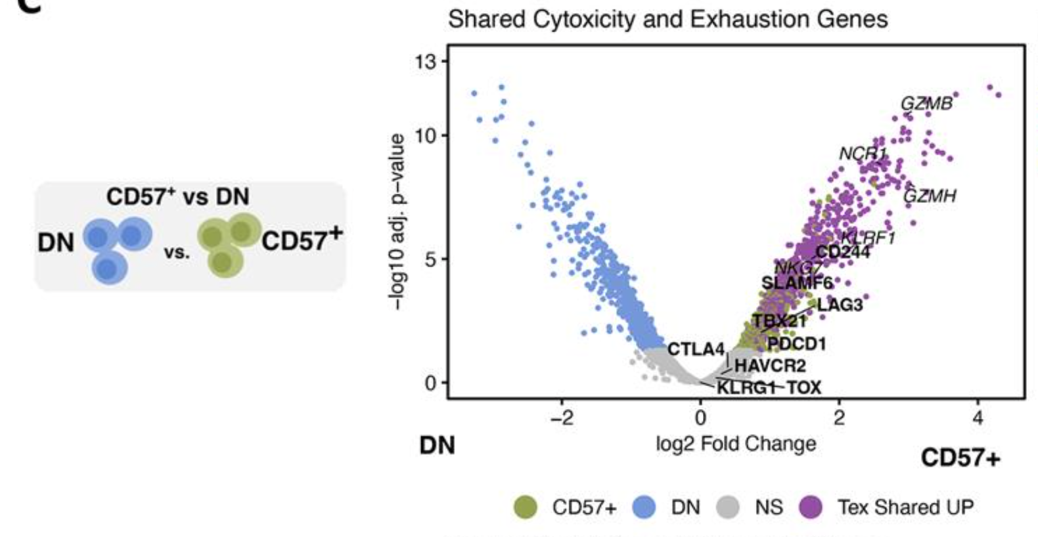
Cytotoxicity and exhaustion genes more accessible in DP CD57⁺ relative to DN in both projects
P576
P452 (Erin’s)

Slide 7
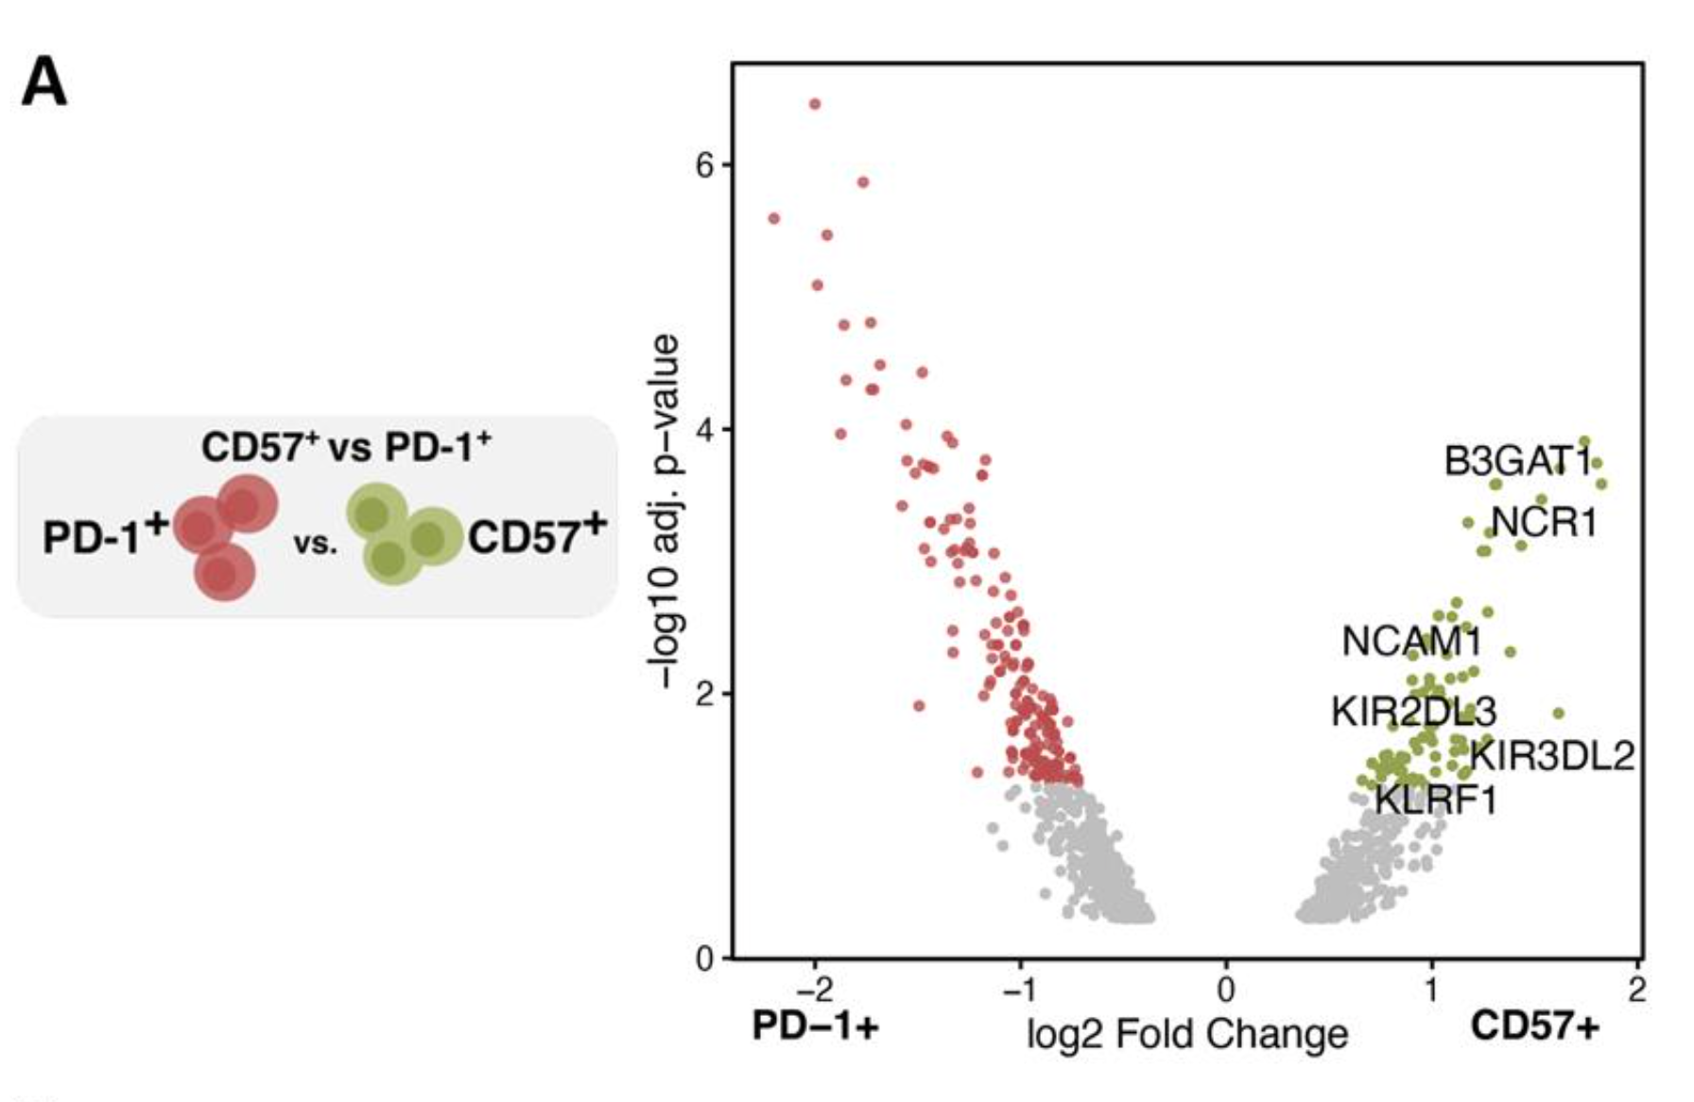
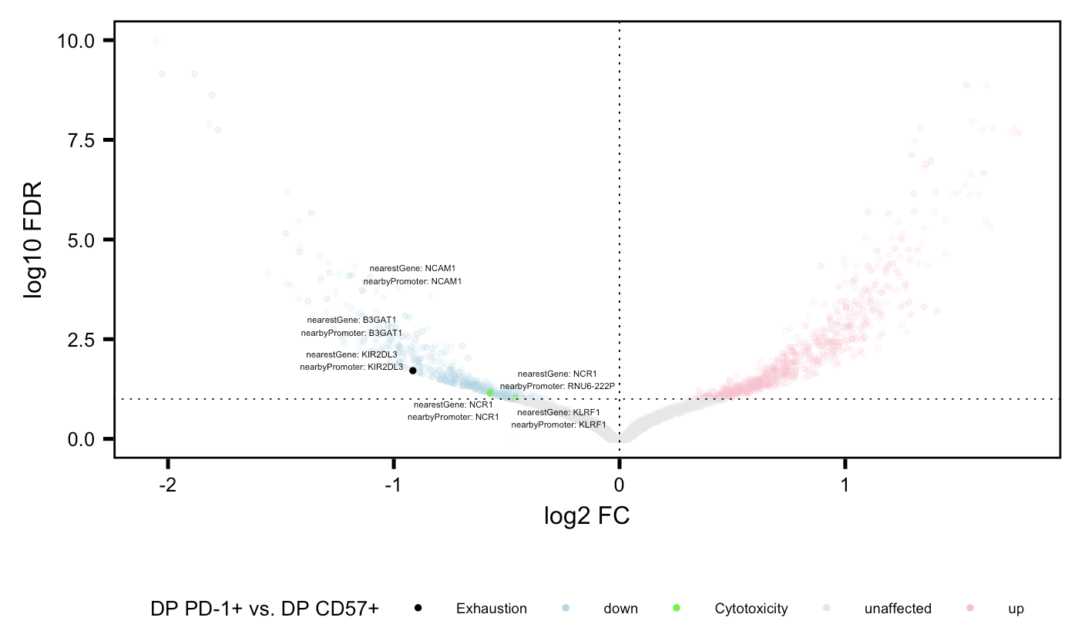
Same genes more accessible in CD57⁺ relative to PD-1⁺ in both projects
P576
P452 (Erin’s)

Slide 8
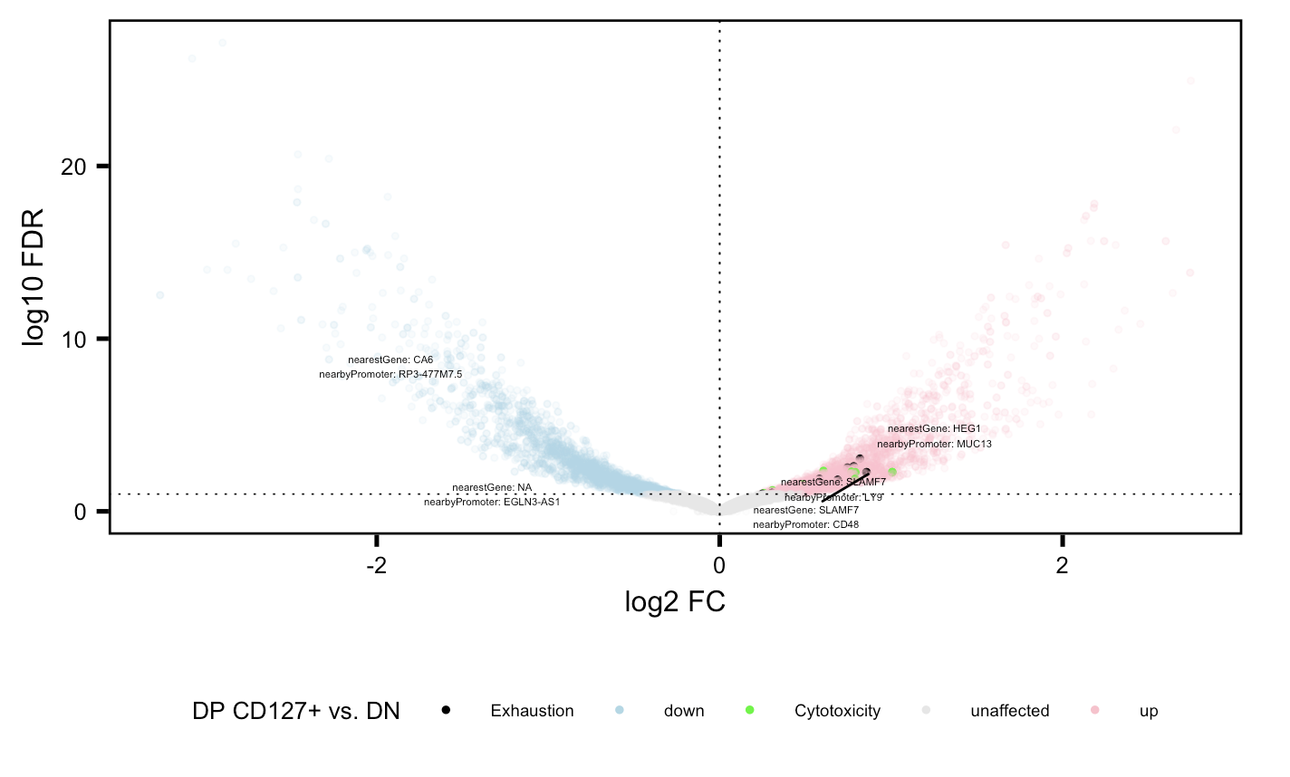
Cytotoxicity and exhaustion genes more accessible in DP CD127⁺ relative to DN

Slide 9
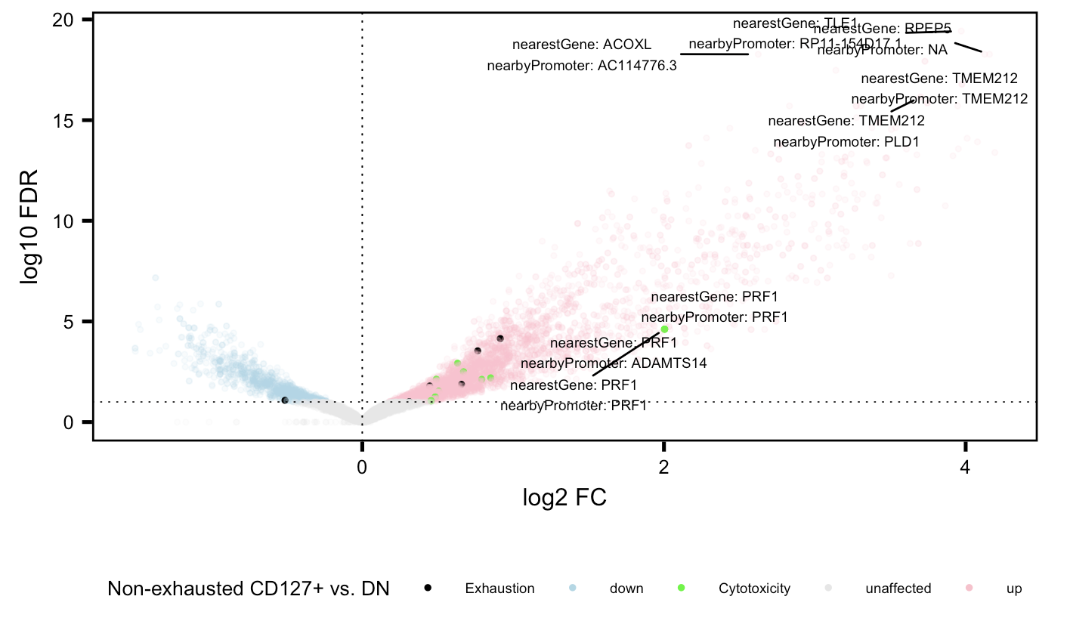
Cytotoxicity and exhaustion genes more accessible in non-exhausted CD127⁺ relative to DN

Slide 10
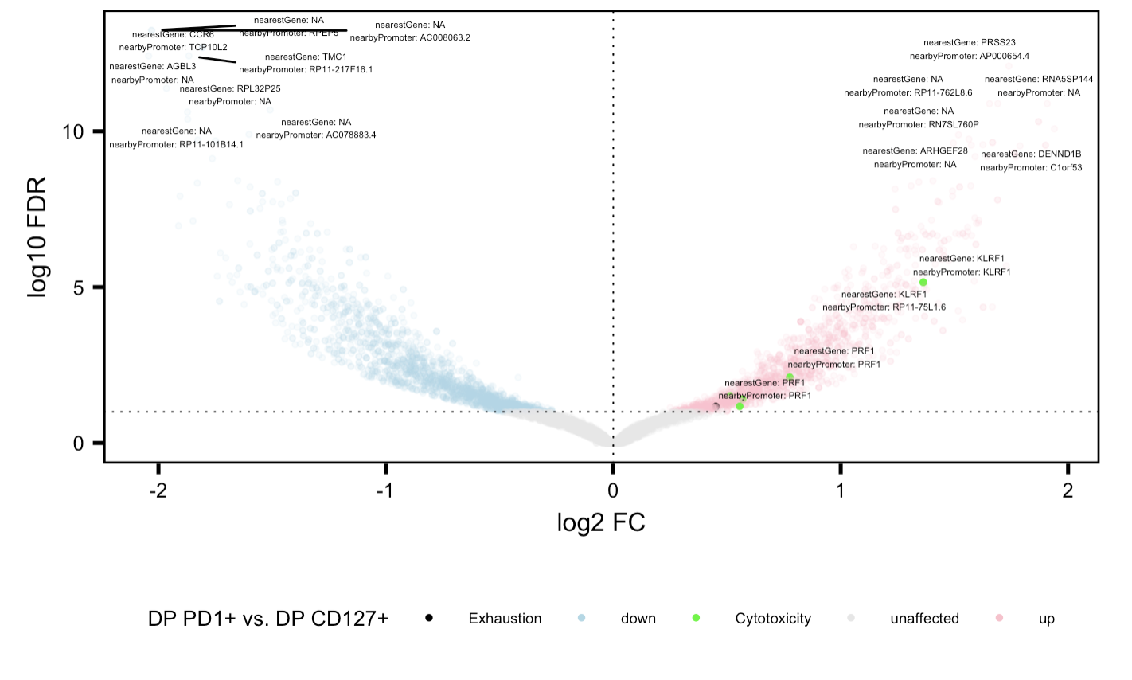
Cytotoxicity genes more accessible in DP PD-1⁺ relative to DP CD127⁺

Slide 11
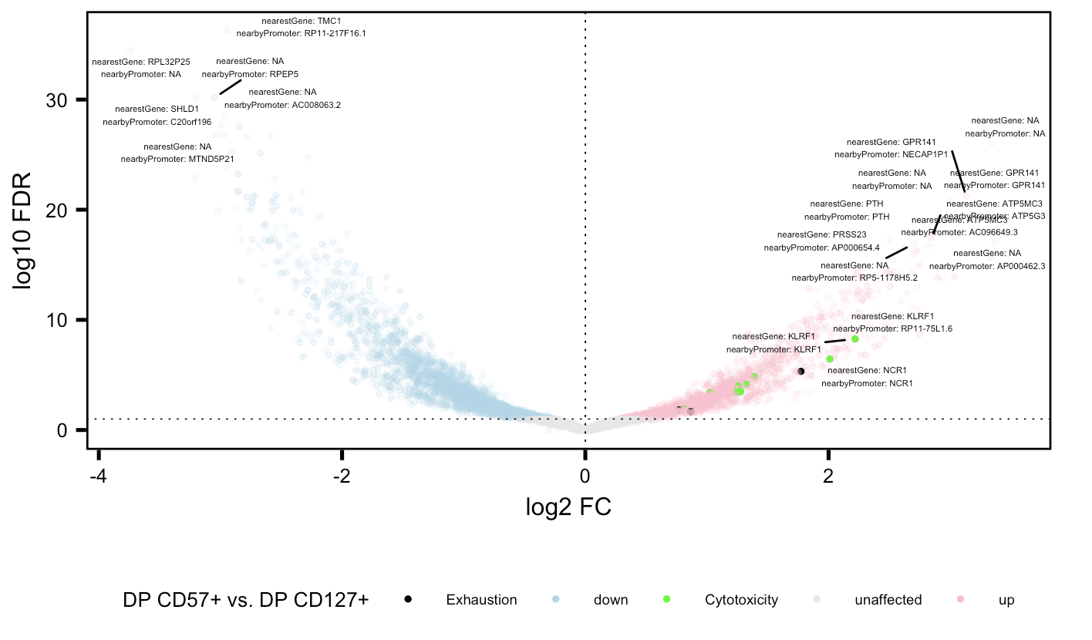
Cytotoxicity and exhaustion genes more accessible in DP CD57⁺ relative to DP CD127⁺

Slide 12
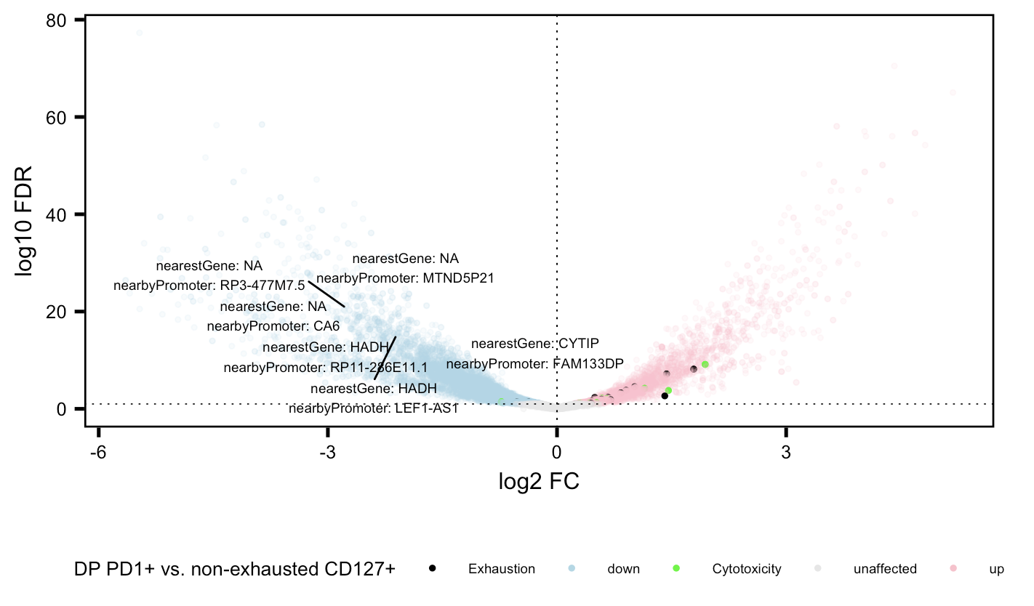
Cytotoxicity and exhaustion genes more accessible in DP PD-1⁺ relative to non-exhausted CD127⁺

Slide 13
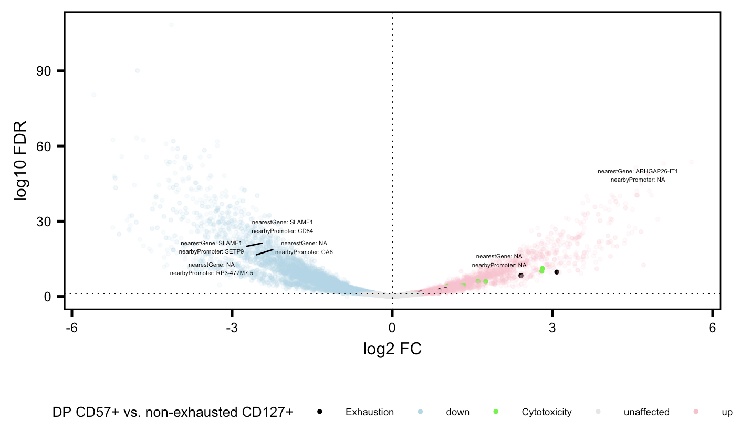
Cytotoxicity and exhaustion genes more accessible in DP CD57⁺ relative to non-exhausted CD127⁺

Slide 14
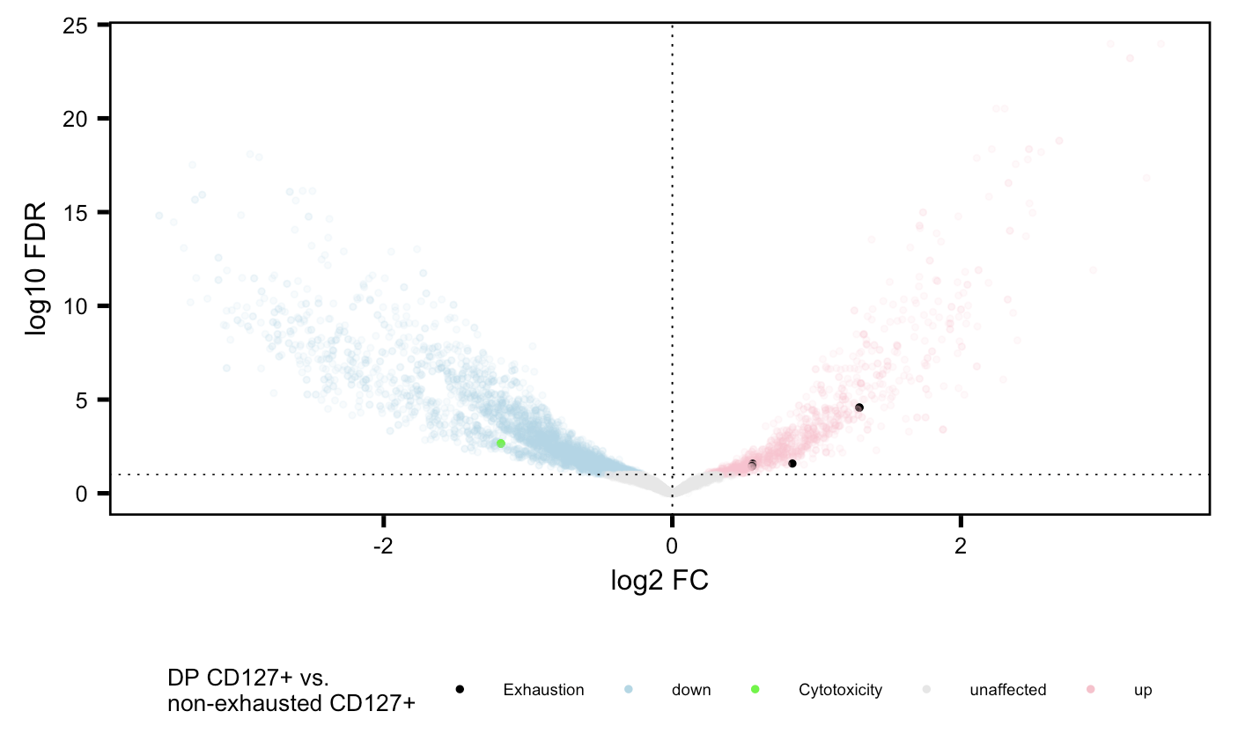
Exhaustion genes more accessible in DP CD127⁺ relative to non-exhausted CD127⁺

Slide 15
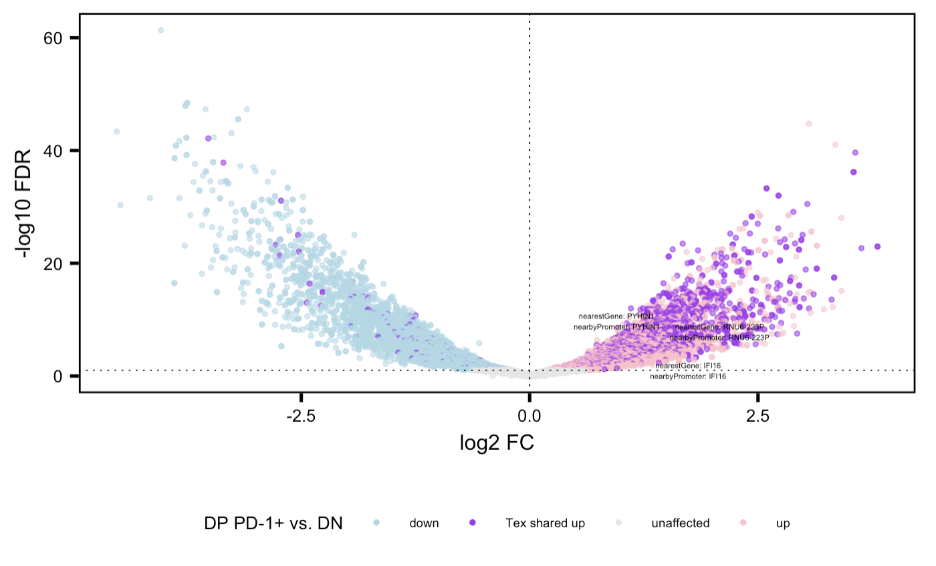
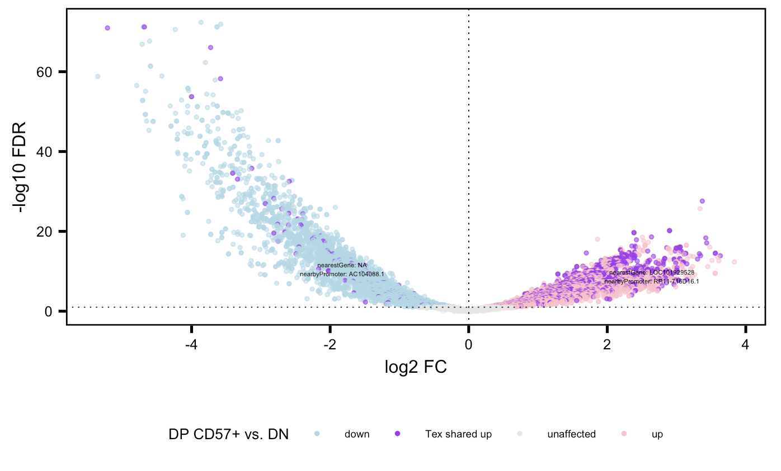
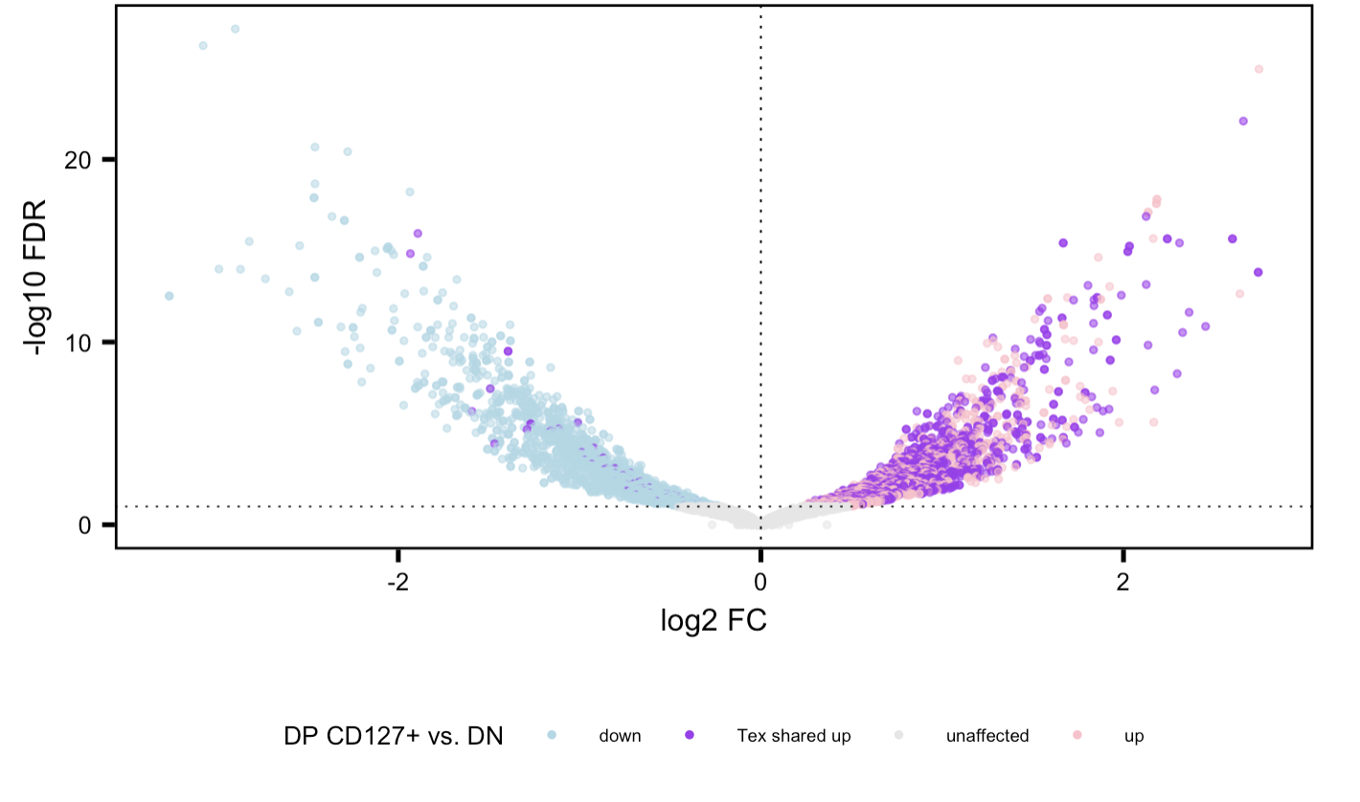
High degree of sharing of up (not necessarily not down) genes b/w 3 cell sorts, more additional unique DARs in DP CD57⁺ consistent across projects
Methods:
1. Filter peaks for positive log2 FC and FDR < 0.05 in each sort vs. DN
2. then look for genes appearing at least once in all 3 lists = T_{ex} shared “up”
Notes:
Erin also saw more sharing dominance in PD-1+ vs CD57+ (i.e. more purple), evident here too

Slide 16
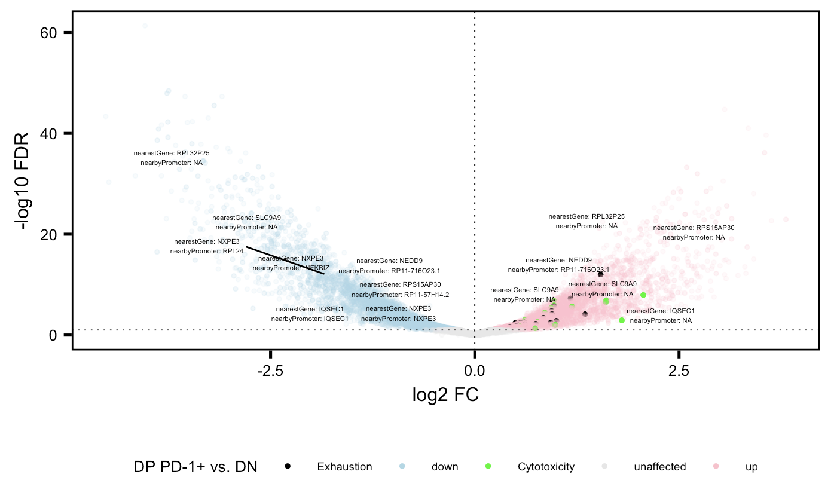
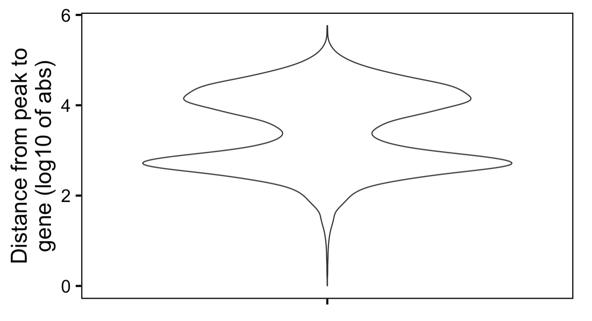
Examples of genes with both sign FCs, seems to be more common at lower abs(FC), most are peaks far away from genes (> 5 kb)
Notes:
Biologically interesting, like bivalent chromatin?

Slide 17
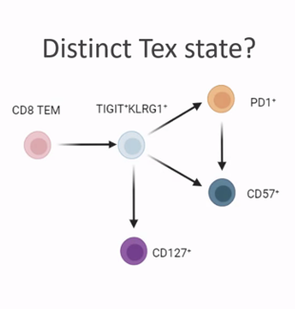
Conclusions
Similar cell sort VP comparisons look similar b/w P576 and P452
New cell sort comparisons
Cytotoxicity and exhaustion genes more accessible in…
DP and non-exhausted CD127⁺ relative to DN
DP CD57⁺ relative to DP CD127⁺
DP PD-1⁺ and DP CD57⁺ relative to non-exhausted CD127⁺
Cytotoxicity genes more accessible in DP PD-1⁺ relative to DP CD127⁺
Exhaustion genes more accessible in DP CD127⁺ relative to non-exhausted CD127⁺
DP CD127⁺ appears to be distinct, non-intermediate cell state from but shares lineage with DP PD-1⁺ and DP CD57⁺
aa link TCR graph looks same as nt link TCR graph (not shown)

Slide 18
Next steps
VP DAR filtering → re-do VPs?
“duplicates” i.e. distinct peaks but all closest to same gene and/or promoter… potentially have different sign FCs, potentially not closest to same gene AND promoter
Filter by distance from peak to gene?
GSEA on up/down genes for each VP
More analysis on data similarity between same cell sorts in P576/P452?

